Slide 1
WELCOME to 92847
Quantitative Biological Research with Python
CLASS 2
NGS & technology & quality
GENCODE
REFSEQ
EXTRA: Biological databases (Examples)
Portals for data integrations

Slide 2
1. NSG technologies
(biological considerations)

Slide 3
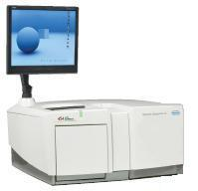
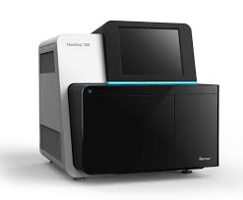
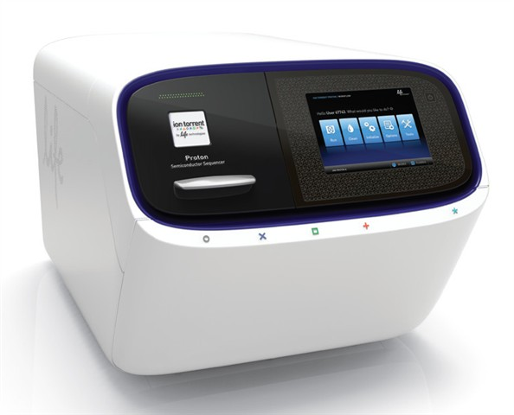
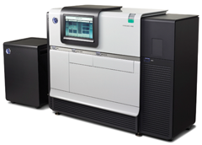
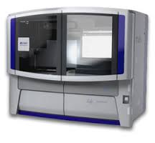
Actual Sequencing Platforms
Roche/454 (GS FLX+/GS Junior)
Illumina Genome Analyzer (HiSeq/MiSeq/NextSeq)
Life Technologies (3500 Genetic Analyzer,
Ion Torrent Proton/PGM)
Pacific Biosciences (PACBIO RSII)
Applied Biosystems (SOLiD, 3730xl DNA Analyzer )

Slide 4
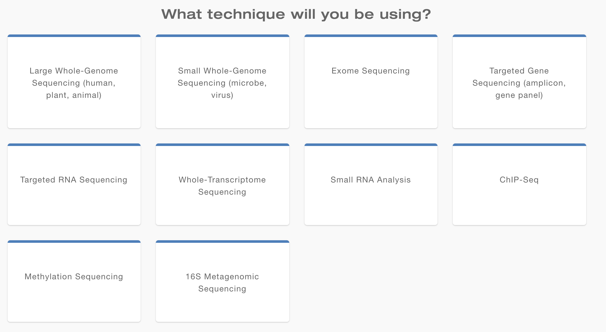
Sequencing Platforms – match your needs

Slide 5
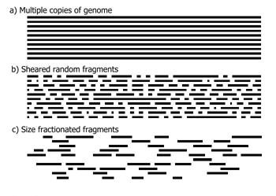
In the lab - Sample
DNA
Sonication (using energy of sound) – usually results in fragments ~700 bp
If suitable fragment size not achieved after shearing, can use gel size-selection

Slide 6
Transcriptomics vs Genomics The notion of completion
Study of the transcriptome :
Always specific circumstances, particular place & time by Microarrays, RNA-seq, Chip-Seq
Comparative mode (a quantitative view)
(before/after treatment, during development, cancer vs normal cells,….)
b. Discovery mode (Assembly transcriptome)
discoveries of novel genes, non-coding RNAs, novel splicing variants of known genes
assembly of a species with unknown genome

Slide 7
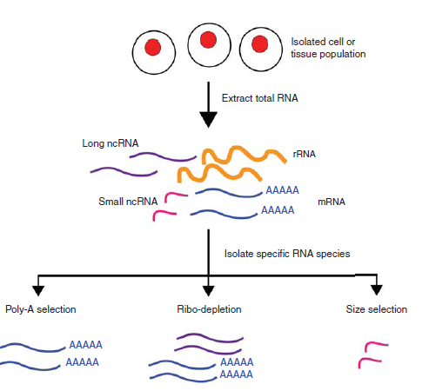
Sample (most important, no glory)
RNA sequencing – Biology proceeds Data
polyA
mRNA selection
Temperature based
fragmentation
Reverse
transcription
Total RNA
mRNA
Fragmented mRNA
cDNA
rRNA depletion

Slide 8
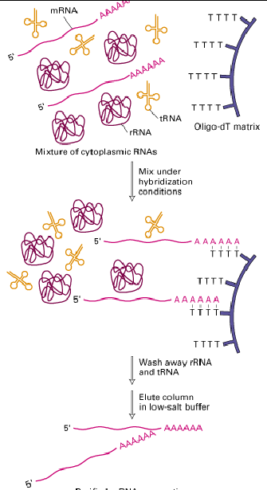
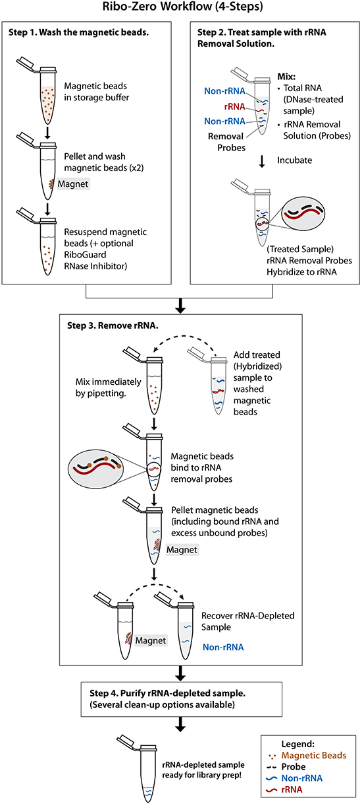
Sample – Enrichment your molecule of interest (e.g. RNA-Seq)
rRNA depletion
polyA selection
Poly A
Cap
RNA modification….

Slide 9
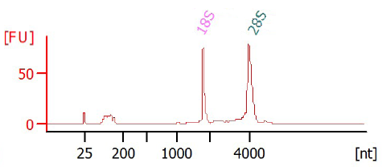
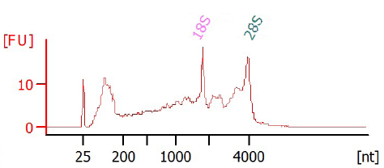
Sample – quality (often hidden)
Samples of high quality
Main challenges: Old / degraded samples
Human brain
Time of extraction
Damaged tissue (proteases, nucleases)
Storage and sharing..
RIN > 9
RIN < 7
Agilent Bioanalyzer profiles
RNA integrity number (RIN). RIN<7 => unequal read distribution along 5’ and 3’ ends

Slide 10
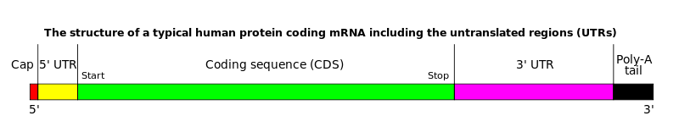
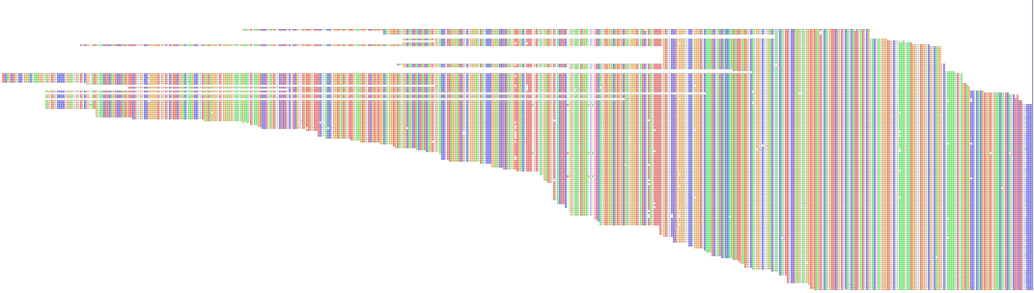
Sample quality & Biological interpretatiopn
Poly A enrichment
Is the gene expressed in the tissue? Valid
What is the gene expression level? Not valid
Alternative splicing ? Not valid
Number of reads

Slide 11
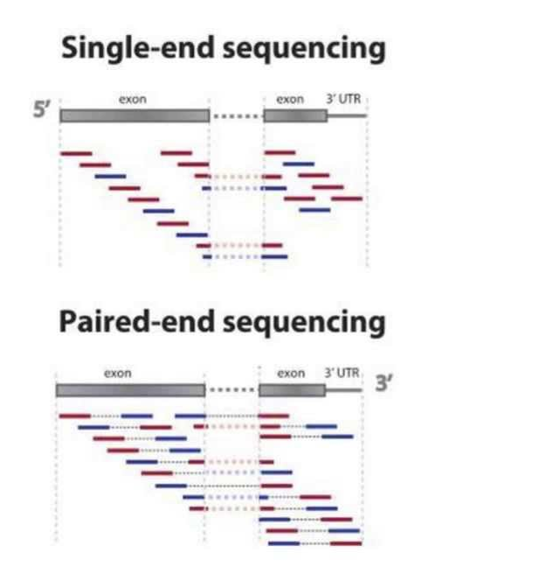
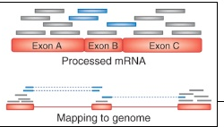
RNA-seq analysis
workflow
sample
fragmentation
library prep
seq run
data analysis

Slide 12
INTRODUCTION TO BIOLOGICAL DATABASES
Where can I find XXX –
Entrez - integrating entry pointer
GeneCode (based on ENCODE)
Refseq
NOTE: Most slides derived from NCBI’s guide
based on J. Gamieldien + others

Slide 13
2. ENCODE

Slide 14
Encyclopedia of DNA Elements (ENCODE)
The primary goal of the ENCODE project is to determine the role of "junk” DNA by determining the location of regulatory elements
The influence on gene transcription regulation of certain genes and the development of disease

Slide 15
ENCODE – Brief
The Encyclopedia of DNA Elements (ENCODE) is a public research consortium initiated by the US National Human Genome Research Institute (NHGRI) in September 2003.
The goal is to find all functional elements in the human genome.
All data generated in the course of the project will be released into public databases.

Slide 16
What’s in the genome?
Alternative ways to define the functional units
- cellular function
- cell localization
-molecular composition

Slide 17
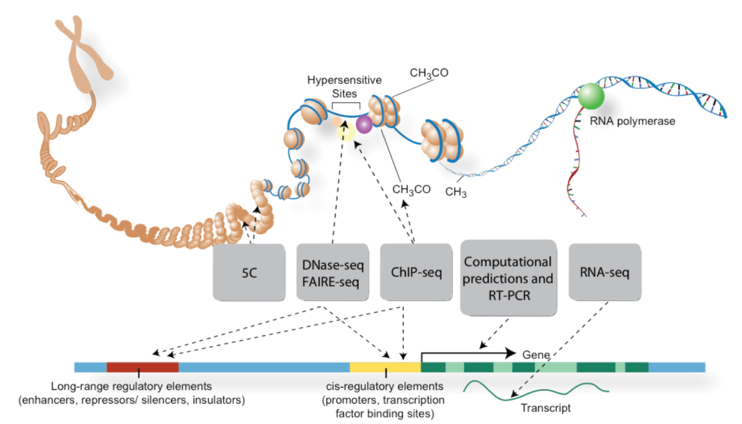
Credits: Darryl Leja (NHGRI), Ian Dunham (EBI)

Slide 18
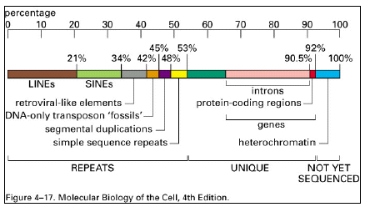
Transcription define by the level of sequence sensitivity (Depth)

Slide 19
ENCODE and quick history
Pilot phase – 2003-2007 – method evaluation
1% of genome
Production phase 2007-2012
September 2012 – 30 papers published
442 scientists
31 labs
147 different types of cells with 24 types of experiments
1,642 experiments
Data released
The ENCODE (ENCylopedia of DNA Elements) Project. The ENCODE Consortium. Science, Vol. 306, 636-640, 22 October 2004

Slide 20
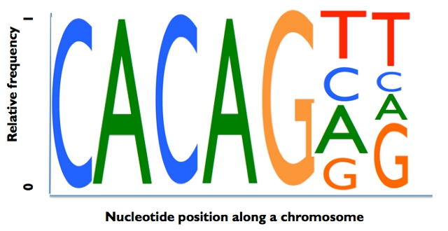
ENCODE annotations are driven by ‘computational’ / bioinformatics
Q: 1. Enrichment of short sequences for TF
2. Are those ‘repeated’ motifs clusrtered?
3. Distances from the TSS?
4. Common / Diversity among cells from same origin? Etc etc…

Slide 21
ENCODE statistics – Regulation..
80% of the human genome participates in at least one biochemical RNA and/or chromatin associated event in at least one cell type.
Classifying the genome into seven chromatin states
400K regions with Enhancers
457 ChIP-seq datasets on 119 TFs in a number of human cell lines
The average profiles of histone modifications and nucleosome positioning around the TF-binding regions
Quantitative properties of Enhancers….

Slide 22
Release 32 (GRCh38.p13)
May 2019
GENCODE project for integrated annotation of gene features.
An extension of ENCODE (by The Wellcome Sanger Institute)
The goal of the GENCODE project is to identify and classify all gene features in the human and mouse genomes with high accuracy based on biological evidence
And to share it all…

Slide 23
Gene Status
Historical…(not valid from Release 25 and on – human; M11 mouse)
Known
Novel
Putative
Known by projection
The majority of GENCODE genes are NOW supported by RefSeq cDNAs or UniProt protein

Slide 24
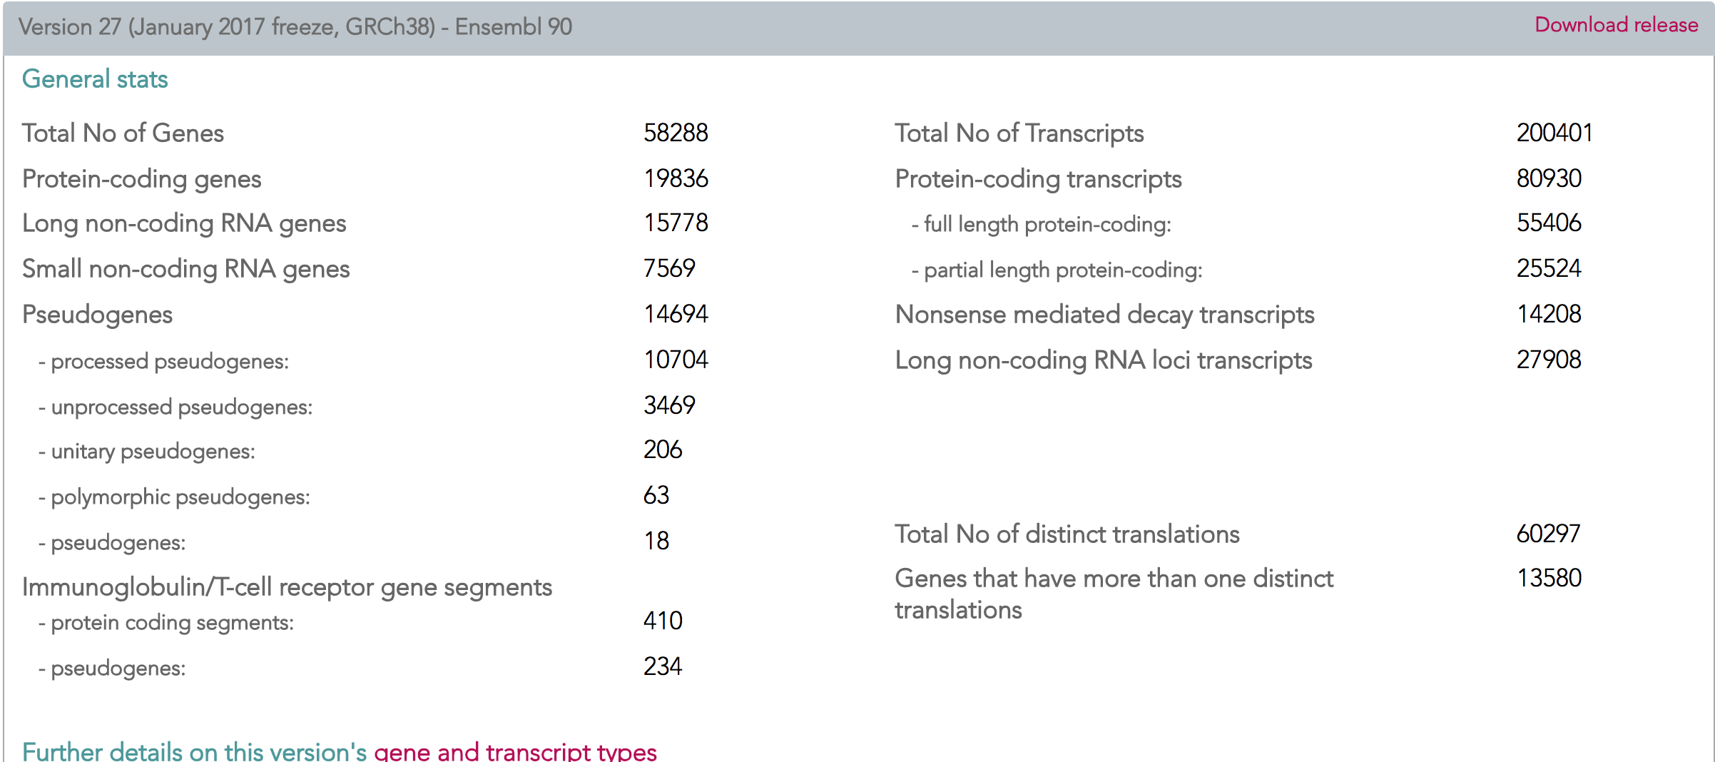
The GENCODE project produces high quality reference gene annotation and experimental validation for human and mouse genomes
Total No of Transcripts (ver 32) | 227462

Slide 25
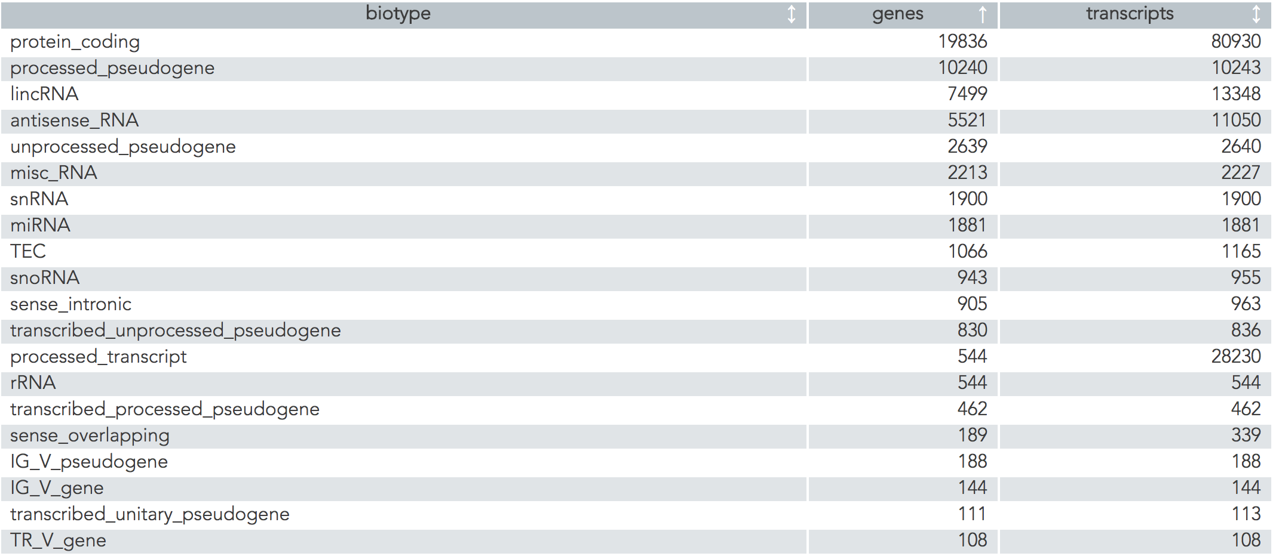
The GENCODE project produces high quality reference gene annotation and experimental validation for human and mouse genomes
Definition the BioTypes:
https://www.gencodegenes.org/gencode_biotypes.html

Slide 26
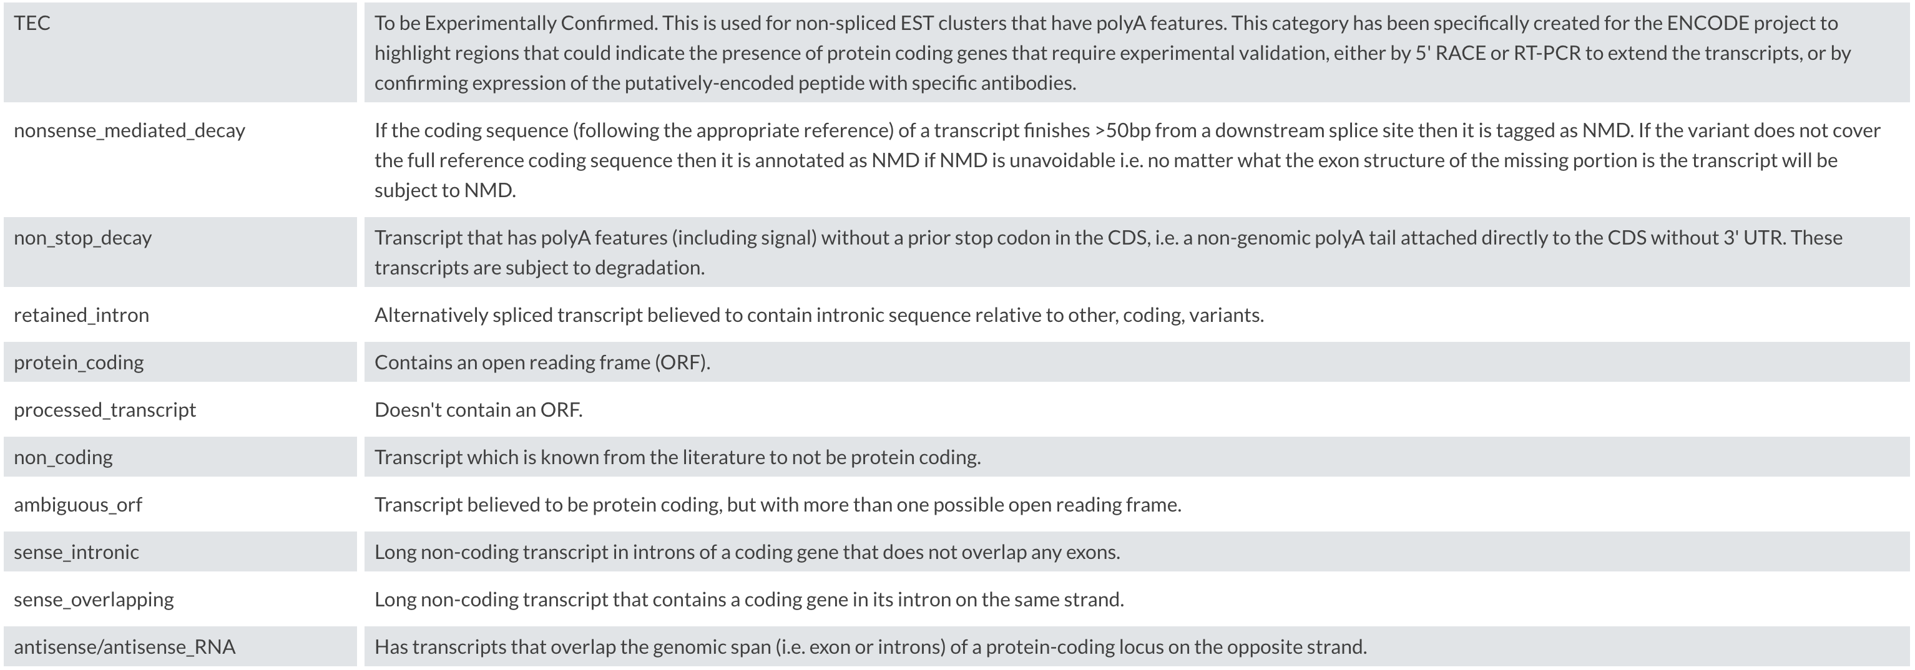
The GENCODE gene annotation for BIOTYPES
Excellent HELP !

Slide 27
GENCODE Biotype - what is included
Small non-coding RNA genes -> counts these gene biotypes:
"snRNA", "snoRNA", "rRNA", "Mt_tRNA", "Mt_rRNA", "misc_RNA", "miRNA", "ribozyme", "sRNA",
"scaRNA", "vaultRNA")

Slide 28
GENCODE – ENSEMBL (fully coordinate)
The Ensembl ids:
"ENS" for human and "ENSMUS" for mouse.
"G" for gene, "T" for transcript, "E" for exon, "P" for translation + 11-number
"ENSG00000182378.10”
Gene names are usually HGNC or MGI-approved gene symbols
https://www.gencodegenes.org/faq.html

Slide 29
GENCODE – Many TAGS that provide rich information on EVIDENCE
GENECODE Transcript support level (TSL)
Not solved:
Annotations in the MHC region and other immunological genes are not evaluated
Genes with no introns – not yet
All intron boundaries must match exactly. The transcript start and end locations are allowed to differ.

Slide 30
The GENCODE project produces high quality reference gene annotation and experimental validation
The GENCODE annotation is made by merging:
(i) Havana manual gene annotation
(ii) Ensembl automated gene annotation
GENCODE GTF General Transfer Format
(i) Genes include also repeated genes from X/ Y Chr
(ii) Experimentally validated tag (APPRIS tags)
APPRIS: APPRIS try to select a single CDS variant for each gene as the 'PRINCIPAL’
https://www.gencodegenes.org/faq.html

Slide 31
GENCODE GTF
column-number | content | values/format
1 | chromosome name | chr{1,2,3,4,5,6,7,8,9,10,11,12,13,14,15,16,17,18,19,20,21,22,X,Y,M} or GRC accession ª
2 | annotation source | {ENSEMBL,HAVANA}
3 | feature type | {gene,transcript,exon,CDS,UTR,start_codon,stop_codon,Selenocysteine}
4 | genomic start location | integer-value (1-based)
5 | genomic end location | integer-value
6 | score(not used) | .
7 | genomic strand | {+,-}
8 | genomic phase (for CDS features) | {0,1,2,.}
9 | additional information as key-value pairs | see below

Slide 32
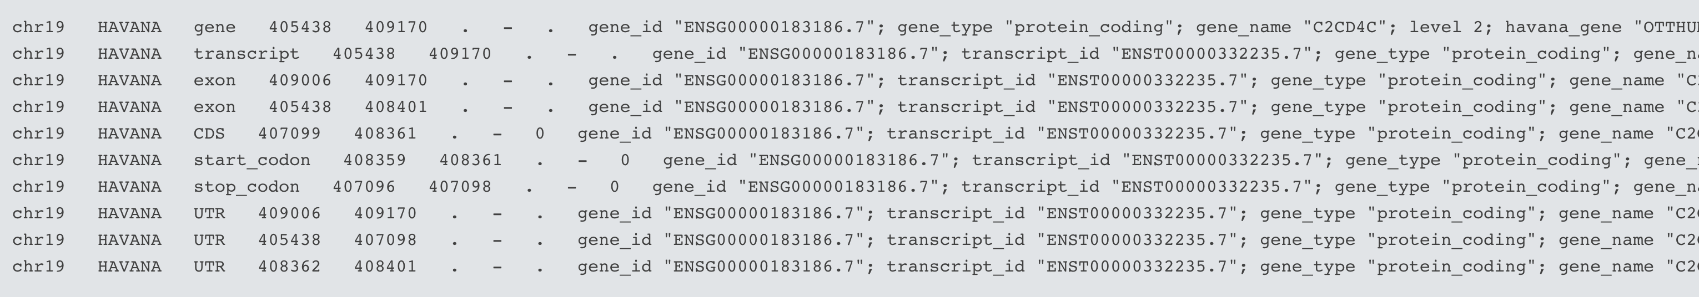
GENCODE GTF
column-number | content | values/format
1 | chromosome name | chr{1,2,3,4,5,6,7,8,9,10,11,12,13,14,15,16,17,18,19,20,21,22,X,Y,M} or GRC accession ª
2 | annotation source | {ENSEMBL,HAVANA}
3 | feature type | {gene,transcript,exon,CDS,UTR,start_codon,stop_codon,Selenocysteine}
4 | genomic start location | integer-value (1-based)
5 | genomic end location | integer-value
6 | score(not used) | .
7 | genomic strand | {+,-}
8 | genomic phase (for CDS features) | {0,1,2,.}
9 | additional information as key-value pairs | see below

Slide 33
GENCODE gene sets are used as reference sets by global resources
Genotype-Tissue Expression (GTEx),
The Cancer Genome Atlas (TCGA),
International Cancer Genome Consortium (ICGC),
NIH Roadmap Epigenomics
Blueprint Epigenome Project,
Exome Aggregation Consortium (EXAC),
Genome Aggregation Database (gnomAD),
1000 Genomes Project
Human Cell Atlas (HCA)

Slide 34
3. Databases

Slide 35
WHAT ARE DATABASES?
Structured collection of information.
Consists of basic units called records or entries.
Each record consists of fields, which hold pre-defined data related to the record.
For example, a protein database would have protein entries as records and protein properties as fields (e.g., name of protein, length, amino-acid sequence)

Slide 36
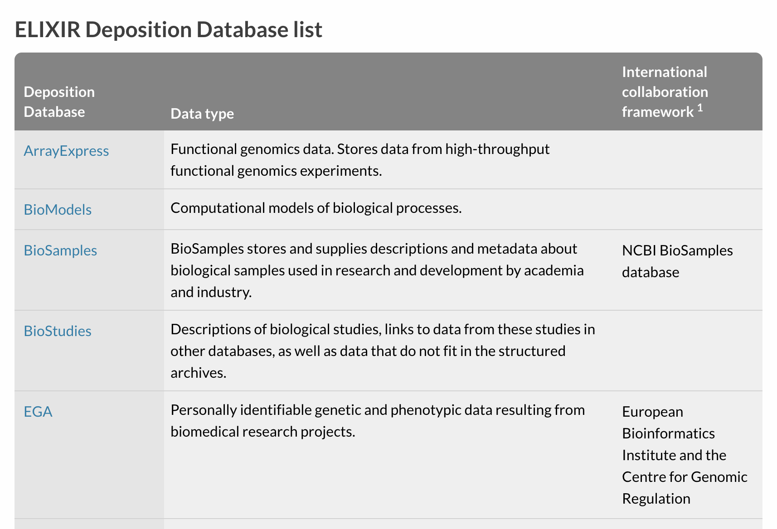
THE ‘PERFECT’ DATABASE
Comprehensive, but easy to search.
Annotated, but not “too annotated”.
A simple, easy to understand structure.
Cross-referenced
Minimum redundancy.
Easy retrieval of data.

Slide 37
THE ‘PERFECT’ DATABASE for PYTHON
Easy to format.. refromat and reformat..
Annotated, documented.
A simple, easy to understand structure/ header.
Easy retrieval of data.
Good /clear /unique indexing..

Slide 38
TYPES OF MOLECULAR DATABASES
Primary Databases
Original submissions by experimentalists
Content controlled by the submitter
Examples: GenBank, Trace, SRA, SNP, GEO
Derivative Databases
Derived from primary data
Content controlled by third party (NCBI)
Examples: NCBI Protein, Refseq, TPA, RefSNP, GEO datasets, UniGene, Homologene, Structure, Conserved Domain
Often
Edited/ Curated/ “already integrated w another Primary “
Your Science…
Curated/ analyzed …
Notes:
Primary databases serve as a repository of experimentalist sequences (GenBank).
Derivative databases are sources of edited/curated sequences (RefSeq…reference sequences, UniGene...genes compared to genetic loci on genomes)

Slide 39
3. NCBI: a Major DB

Slide 40
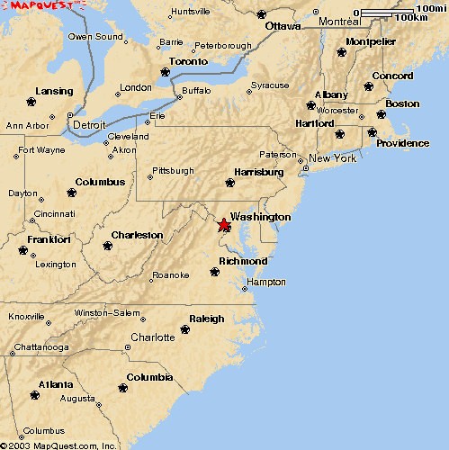
The National Center for Biotechnology Information
NCBI
Bethesda,MD
Created in 1988 as a part of the National Library of Medicine at NIH
Establish public databases
Research in computational biology
Develop software tools for sequence analysis
Disseminate biomedical information

Slide 41
PRIMARY VS. DERIVATIVE SEQUENCE DATABASES
ACGTGC
RefSeq
C
C
GA
GA
Labs
ATT
GA
C
GA
ATT
C
TATAGCCG
AGCTCCGATA
CCGATGACAA
TATAGCCG
Sequencing
Centers
ACGTGC
Genome
Assembly
ATTGACTA
CGTGA
Curators
TTGACA
Updated
continually
by NCBI
TTGACA
TTGACA
ACGTGC
CGTGA
ACGTGC
TATAGCCG
CGTGA
ATTGACTA
TATAGCCG
TATAGCCG
ATTGACTA
CGTGA
ATTGACTA
ATTGACTA
ATTGACTA
ATT
TATAGCCG
TATAGCCG
TATAGCCG
TATAGCCG
TATAGCCG
TTGACA
C
GA
GenBank
UniGene
Updated ONLY
by submitters
AT
C
C
C
C
ATT
GA
GA
GA
ATT
GA
ATT
ATT
GA
GA
GA
ATT
C
C
GA
C
ATT
C
Algorithms
Notes:
~11,000 sequences are submitted per day.

Slide 42
Sequence Databases at NCBI
Primary
GenBank: NCBI’s primary sequence database
Trace Archive: reads from capillary sequencers (TAR)
Sequence Read Archive (SRA): next generation data
Derivative
GenPept (GenBank translations)
Outside Protein (UniProt—Swiss-Prot, PDB)
NCBI Reference Sequences (RefSeq)

Slide 43
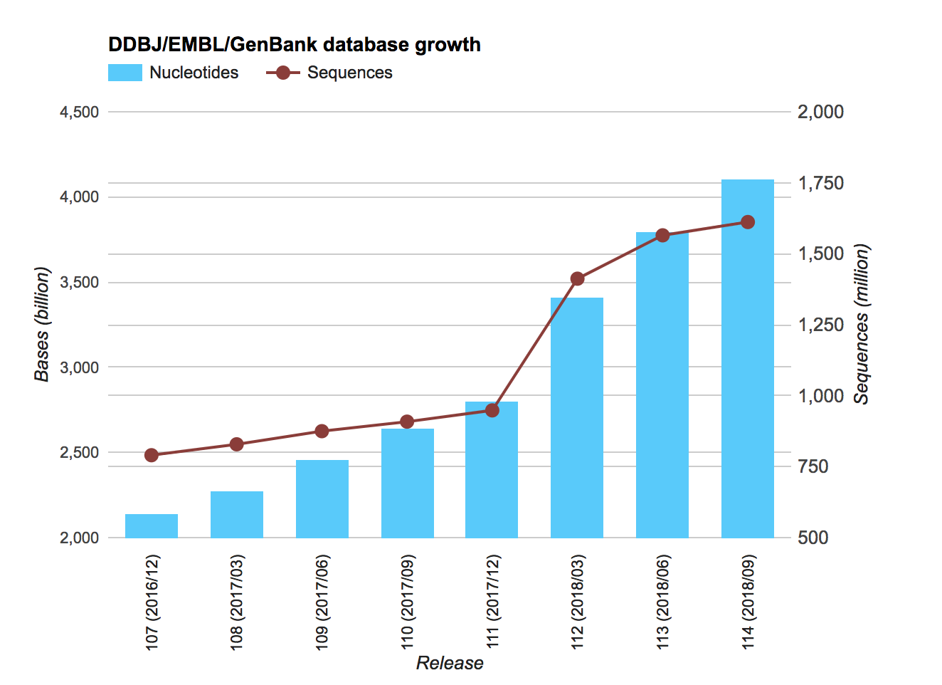
GENBANK - PRIMARY SEQUENCE DB (2)
Three collaborating databases
International Nucleotide Sequence Database Collaboration
GenBank
DNA Database of Japan (DDBJ)
European (EMBL) Database

Slide 44
Sequence repositories - GenBank et al.
GenBank / EMBL / DDBJ
Highly redundant (many versions of same gene)
Cross-updated daily
Version history is recorded
Previous sequence records can be retrieved
Contigs/HTGS (100-200 kb) finishing at different stages
Draft → Finished
Includes genomic DNA, cDNA, ESTs, translated peptides

Slide 45
Non-redundant and Curated databases
Non-redundant
Manual or automatic curation
DNA
RefSeq (NCBI; semi-automated)
Ensembl gene index (automated)
Protein
RefSeq (NCBI; semi-automated)
TrEMBL (EMBL; automated)

Slide 46
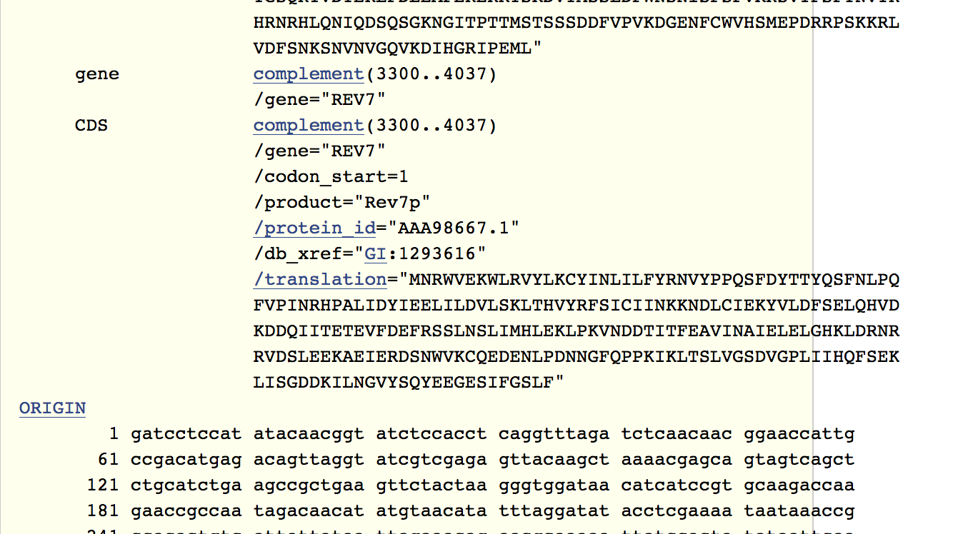
CURRENT GenBank Record - Details

Slide 47
REFSEQ: DERIVATIVE SEQUENCE DATABASE
Curated transcripts and proteins
Model transcripts and proteins
Assembled Genomic Regions
Chromosome records
Human genome
microbial
organelle
ftp://ftp.ncbi.nih.gov/refseq/release/
Notes:
Goal= nonredundant set of genes/proteins for each organism represented
Model= comes from analysis of genomic content from organism assembly
Reannotation of microbial genomes, for example.

Slide 48
GENBANK - PRIMARY SEQUENCE DB (2)
ILLUSTRATION
Lynx1 –human
Park7
…

Slide 49
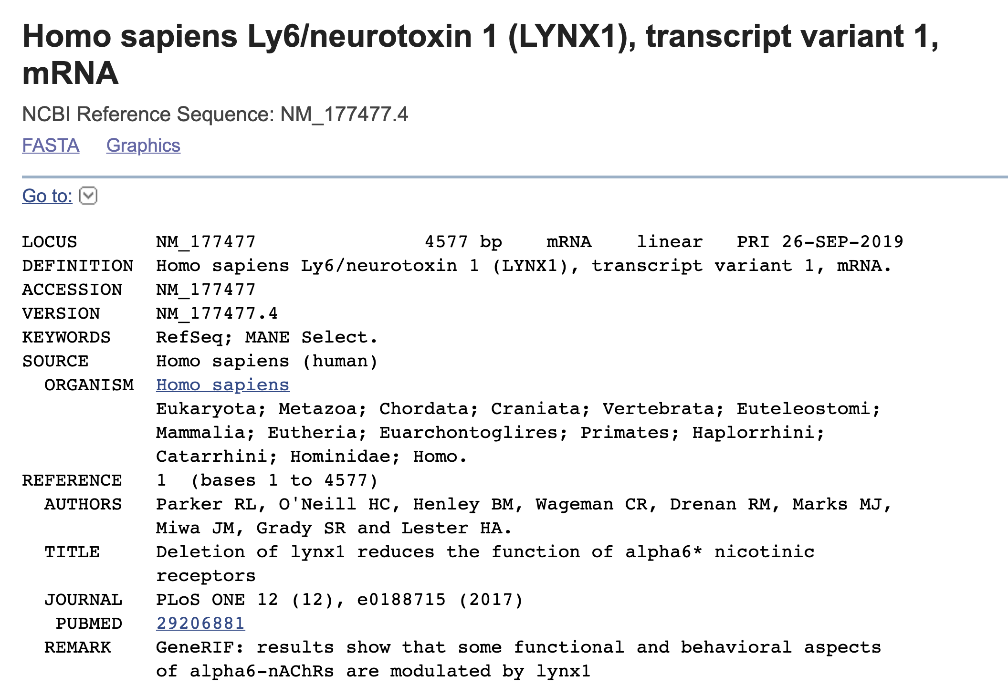

Slide 50
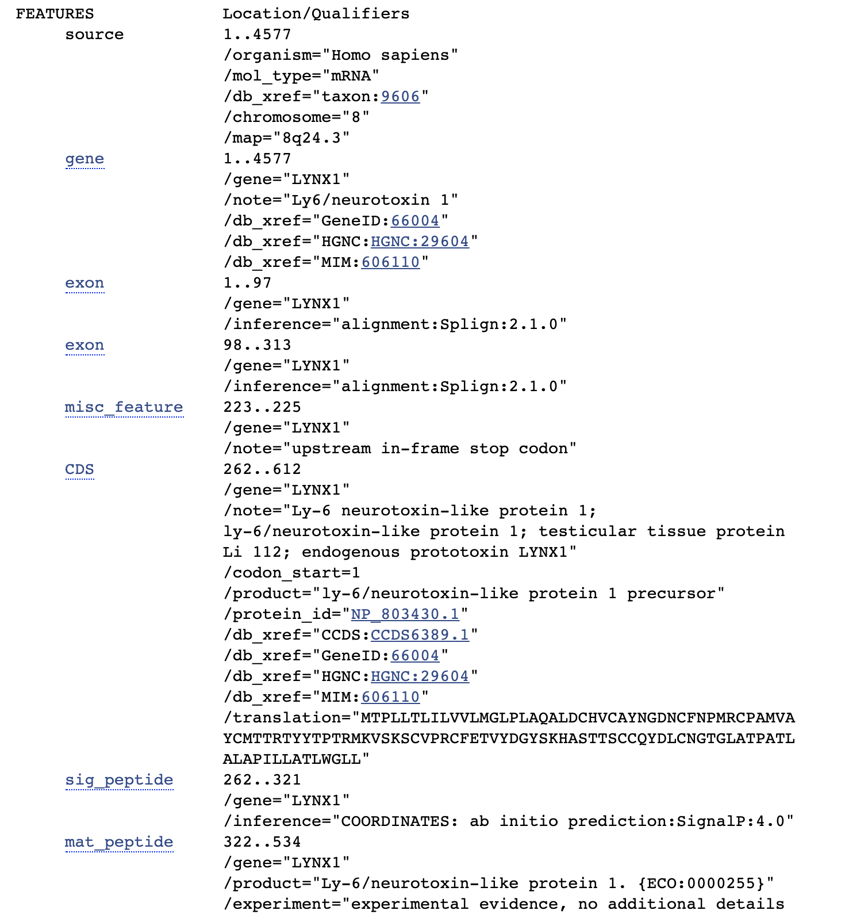

Slide 51
4. RefSeq

Slide 52
NCBI REFSEQ
GOAL:
RefSeq sequences generated to provide reference standards for multiple purposes ranging from genome annotation to reporting locations of sequence variation in medical records.
Important:
The RefSeq collection is available without restriction
The RefSeq collection is available only for model organism
.
Notes:
The first letter in the accession makes a notation of the source database - SRA, EBI, or DDBJ

Slide 53
NCBI REFSEQ - HISTORY
2011: RefSeq includes sequences from 12,000 taxonomy
It represents chromosomes, organelles, plasmids, viruses, transcripts, and more >12 million proteins.
Updated Daily
RefSeq records appear similar in format to GenBank records.
Notes:
The first letter in the accession makes a notation of the source database - SRA, EBI, or DDBJ

Slide 54
NCBI REFSEQ
RefSeq DB is a collection of non-redundant annotated sequences representing naturally occurring molecules (DNA, RNA, Proteins)
RefSeq is a synthesis of information integrated across multiple sources/
RefSeqs provide a foundation for uniting sequence data with genetic and functional information.
Linked to
PubMed, Nucleotide, Protein, Gene, and Map Viewer, searching with a sequence via BLAST, and downloading from the RefSeq FTP site.
Notes:
The first letter in the accession makes a notation of the source database - SRA, EBI, or DDBJ

Slide 55
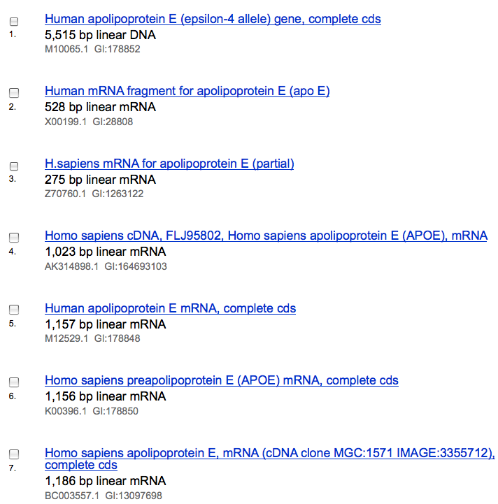
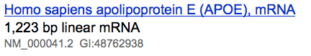
GenBank to RefSeq

Slide 56
RefSeq Benefits
Non-redundancy
Updates to reflect current sequence data and biology
Data validation
Format consistency
Distinct accession series
Approved by NIH/ collaborators

Slide 57
NCBI REFSEQ
Definitions:
Model RefSeq: RNA and protein products that are generated by the eukaryotic genome annotation pipeline. These records use accession prefixes XM_, XR_, and XP_.
Known RefSeq: RNA and protein products that are mainly derived from GenBank cDNA and EST data and are supported by the RefSeq eukaryotic curation group. These records use accession prefixes NM_, NR_, and NP_.
Notes:
The first letter in the accession makes a notation of the source database - SRA, EBI, or DDBJ

Slide 58
RefSeq: Products
Goal: One sequence entry for each naturally occurring molecule
Multiple products for one gene are instantiated as separate RefSeqs with the same LocusID.
chromosome
gene
NC_000000
NG_000000
protein
mRNA
contig
NT_000000
NM_000000
NP_000000
Key:
curated
calculated
model mRNA
model protein
XM_000000
XP_000000
Notes:
The first letter in the accession makes a notation of the source database - SRA, EBI, or DDBJ

Slide 59
NCBI REFSEQ-X – clarification
RefSeq mRNA and protein do not providing explicit coordinates for flanking or intronic sequence.
RefSeq chromosome sequences do provide explicit coordinates no matter the relationship to any gene annotation. Unstable !
RefSeqGene providing more stable gene-specific genomic sequence for each gene, as well as including upstream and downstream flanking regions.
Notes:
The first letter in the accession makes a notation of the source database - SRA, EBI, or DDBJ

Slide 60
Selected RefSeq Accession Numbers
mRNAs and Proteins
NM_123456 Curated mRNA
NP_123456 Curated Protein
NR_123456 Curated non-coding RNA
XM_123456 Predicted mRNA
XP_123456 Predicted Protein
XR_123456 Predicted non-coding RNA
Gene Records
NG_123456 Reference Genomic Sequence
Chromosome
NC_123455 Microbial replicons, organelle genomes, chromosomes
AC_123455 Alternate assemblies
Assemblies
NT_123456 Contig
NW_123456 WGS Supercontig
Notes:
Two letter prefix, underscore, numeric portion.
NT=contig assemblies produced by NCBI
NW=supercontig assembles from WGS

Slide 61
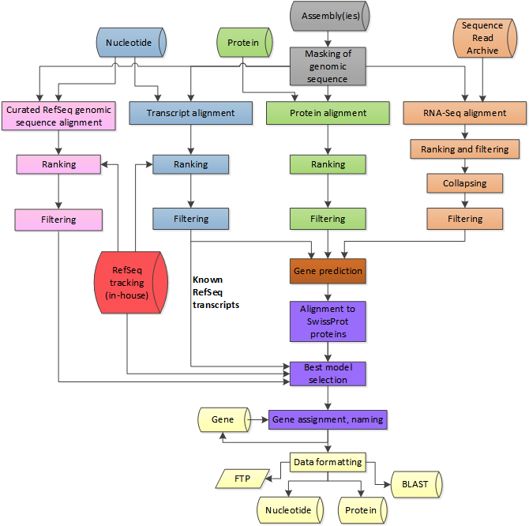
GENOME ANNOTATION PIPLINE
Very stable pipeline
Essential for consistency
NEW RELEASE - important updates..
Notes:
https://www.ncbi.nlm.nih.gov/genome/annotation_euk/process/

Slide 62
Other Derivative Databases
https://www.ncbi.nlm.nih.gov/books/NBK21091/
Expressed Sequences
dbSNP
Structure
Gene

Slide 63
5. Integration
(next class)

